Slide 1
PROBLEM STATEMENT
Underwater Wireless Sensor Network (UWSN) [1-3]:
Environmental monitoring
Disaster prevention
Tactical Surveillance
Undersea exploration
Problem in UWSN
Attenuation caused by spreading and absorption.
Low frequency, bandwidth and bitrate.
Low transmission and coverage range High transmission and overhead energy. Energy limitation of UWSN battery.
High node failure and low network lifetime

Slide 2
COMPARISON
AUTHORSc | TECHNIQUE | DEPLOYMENT | SCALABILITY | ENERGY EFFICIENCY | LOAD DISTRIBUTION | COMPLEXITY | LIMITATION
ULEACH [4] | Random based cluster head selection | Random 3D | Low | Low | Low | Low | CH selection is based on random probability Node failure easily occurs during single hop transmission
DEKCS [5] | Energy based K-Means clustering | Random 2D | Low | Moderate | Moderate | Moderate | CH selection is based on constant energy threshold Node failure easily occurs during single hop transmission
FBC [6] | Fuzzy Logic clustering | Random 2D | Low | Moderate | Low | Moderate | Only considering distance as a parameter
HChOA [7] | Hierarhical Chimp Optimization based for Clustering and Multi-Hop | Random 2D | High | High | High | High | The sensitivity of hyperparameters is high because parameter selection has a high influence on transmission effectiveness
EEMM [8] | Markov probability Multi-Hop | Deterministic 2D | Low | Moderate | Low | Moderate | Only considering distance as a parameter
QELAR [9] | Q-Learning Multi-Hop | Random 3D waypoint | High | Moderate | High | High | High energy overhead due to flat-based protocol
MCR-UWSN [10] | Emperor penguin optimizer based clustering with grasshopper optimization | Random 2D | Low | High | High | High | The sensitivity of hyperparameters is high because parameter selection has a high influence on transmission effectiveness

Slide 3
PURPOSES AND NOVELTIES
Research Purposes :
Increase the scalability and coverage range of UWSN.
Improve load balance and energy efficiency of UWSN.
Reduce the number of node failure and increase network lifetime.
Novelty :
The use of the k-means algorithm in cluster head selection with the shiloutte method to determine the optimum value of the cluster based on the distance value and residual energy from each sensor
The use of multi-agent reinforcement learning based on Q-Learning in multi-hop transmission between cluster heads to determine the optimum path in the transmission process.
The use of trilateration-based deployment to increase sensing range and reduce transmission distance between nodes

Slide 4
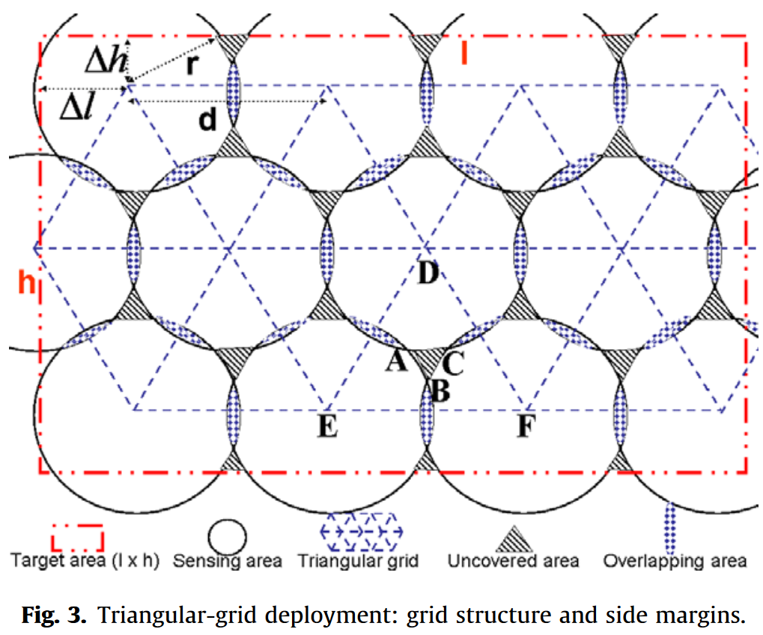

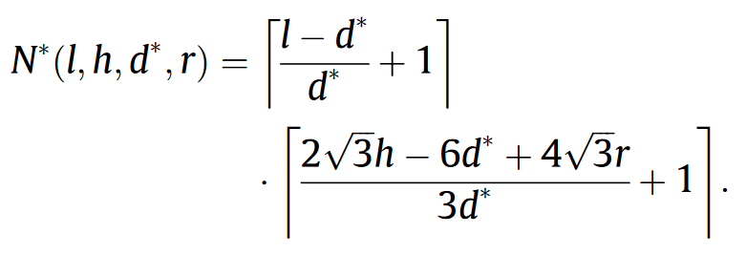
DEPLOYMENT MODEL
[11]
*Ilustrasi dari pemodelan yang akan dilakukan
Acoustic sensor

Slide 5
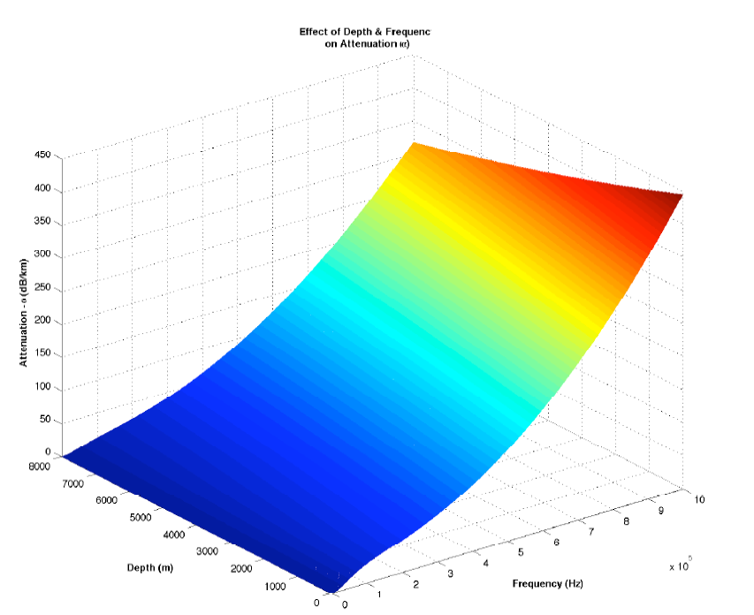

PROPAGATION MODEL
Propagation Loss
Ainslie & McColm Equation
$$α\left(f\right)=0.106\frac{f_{1}f^{2}}{f_{1}^{2}+f^{2}}e^{\frac{pH−s}{0,56}}+0.52\left(1+\frac{T}{43}\right)\left(\frac{S}{35}\right)\frac{f_{2}f^{2}}{f_{2}^{2}+f^{2}}e^{\frac{−D}{0.56}}+4.9×{10}^{−4}f_{2}∙e^{\left(\frac{T}{27}+\frac{D}{17}\right)}$$
$f_{1}=0.78\sqrt{\frac{S}{35}}$ $e^{\frac{T}{26}}$, ${ f}_{2}=42$ $e^{\frac{T}{17}}$
$$A\left(d,f\right)=d^{k}{α\left(f\right)}^{d}$$
Propagation delay
MacKenzie Equation
$v_{uw}=1448.96+4.591∙T−5.304×{10}^{−2}T^{2}+2.374T^{3}+1.340∙\left(S−35\right)+1.630$ $×{10}^{−2}∙D$
$+1.675×{10}^{−7}D^{2}−1.025$ $×{10}^{−2}$ $∙T$ $∙\left(S−35\right)−7.139×{10}^{−13}{∙D}^{3}∙T$
$$τ_{propagation} =\frac{d}{v_{uw}}$$
*Referensi [12]

Slide 6
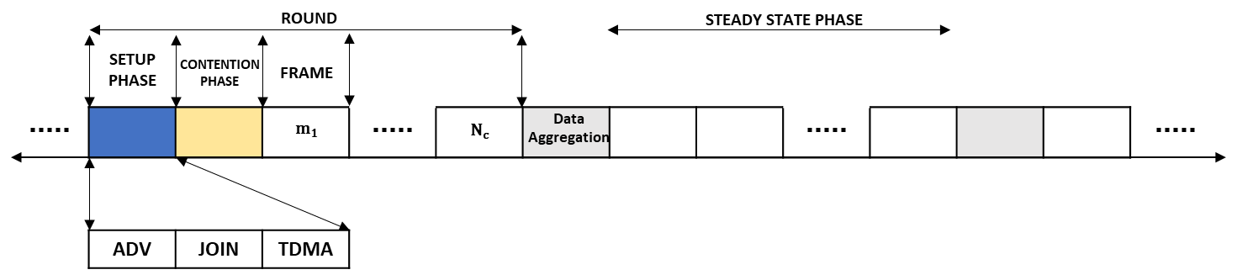
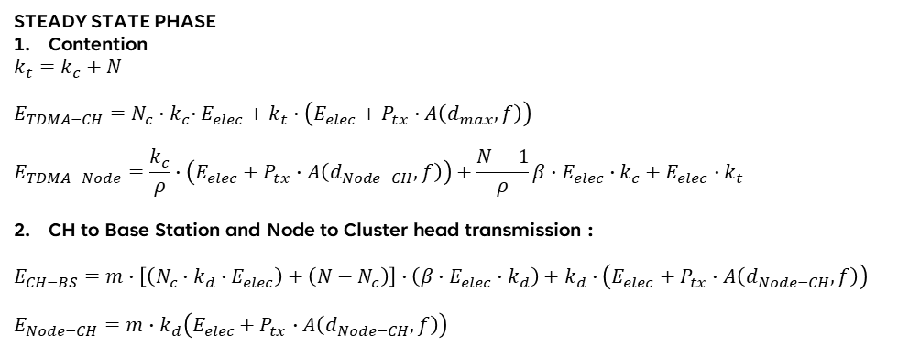
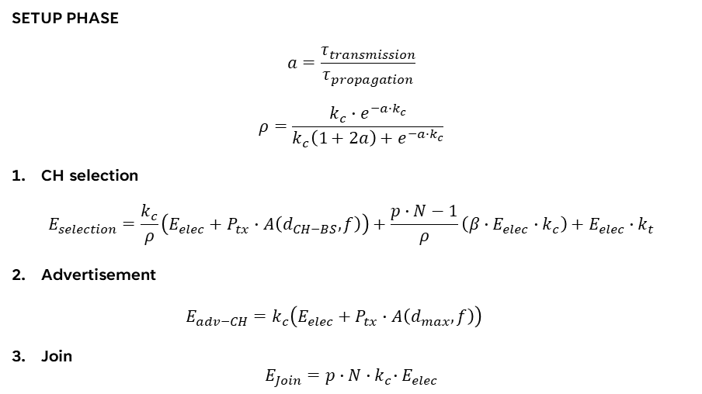
ENERGY MODEL
SETUP PHASE
$$a=\frac{τ_{transmission}}{τ_{propagation}}$$
$$ρ=\frac{k_{c}∙e^{−a∙k_{c}}}{k_{c}\left(1+2a\right)+e^{−a∙k_{c}}}$$
CH selection
$$E_{selection}=\frac{k_{c}}{ρ}\left(E_{elec}+P_{tx}∙A\left(d_{CH−BS},f\right)\right)+\frac{p∙N−1}{ρ}\left(β∙E_{elec}∙k_{c}\right)+E_{elec}∙k_{t}$$
Advertisement
$$E_{adv−CH}=k_{c}\left(E_{elec}+P_{tx}∙A\left(d_{max},f\right)\right)$$
Join
$$E_{Join}=p∙N{∙k}_{c}∙E_{elec}$$
STEADY STATE PHASE
Contention
$$k_{t}=k_{c}+N$$
$$E_{TDMA−CH}=N_{c}{∙k}_{c}∙E_{elec}+k_{t}∙\left(E_{elec}+P_{tx}∙A\left(d_{max},f\right)\right)$$
$$E_{TDMA−Node}=\frac{k_{c}}{ρ}∙\left(E_{elec}+P_{tx}∙A\left(d_{Node−CH},f\right)\right)+\frac{N−1}{ρ}β∙E_{elec}∙k_{c}+E_{elec}∙k_{t}$$
CH to Base Station and Node to Cluster head transmission :
$$E_{CH−BS}=m∙\left[\left(N_{c}∙k_{d}∙E_{elec}\right)+\left(N−N_{c}\right)\right]∙\left(β∙E_{elec}∙k_{d}\right)+k_{d}∙\left(E_{elec}+P_{tx}∙A\left(d_{Node−CH},f\right)\right)$$
$$E_{Node−CH}=m∙k_{d}\left(E_{elec}+P_{tx}∙A\left(d_{Node−CH},f\right)\right)$$
*Referensi [4][12-14]]
[

Slide 7


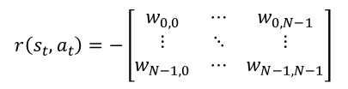
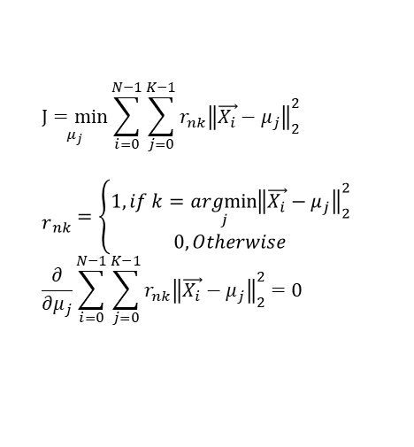











$$w_{0,1}$$
CH SELECTION AND TRANSMISSION MODEL
$$Fully Connected Graph$$
$${CH}_{2}$$
$${CH}_{0}$$
$$w_{0,2}$$
$$w_{1,n}$$
$${CH}_{1}$$
$${CH}_{n}$$
$$K−Mean based Cluster Head Selection$$
$${CH=[CH}_{0}, {CH}_{1},{CH}_{2},…{CH}_{N−1}]$$
$$\underset{μ_{j}}{J=min}{\sum_{i=0}^{N−1}{\sum_{j=0}^{K−1}{r_{nk}{\left\|\vec{X_{i}}−μ_{j}\right\|}_{2}^{2} }}}$$
$${\begin{aligned} \\ r\end{aligned}}_{nk}=\left\{\begin{aligned}1, if k=\underset{j}{argmin}{{\left\|\vec{X_{i}}−μ_{j}\right\|}_{2}^{2}} \\ 0, Otherwise\end{aligned}\right.$$
$$\frac{∂}{∂μ_{j}}\sum_{i=0}^{N−1}{\sum_{j=0}^{K−1}{r_{nk}{\left\|\vec{X_{i}}−μ_{j}\right\|}_{2}^{2}}=0}$$
$$d_{j,i} =\sqrt{{\left(x_{j}−x_{i}\right)}^{2}+{\left(y_{j}−y_{i}\right)}^{2}+{\left(z_{j}−z_{i}\right)}^{2}}$$
$$z_{i}^{1}=\frac{x_{i}^{1}−μ_{\overset{→}{X}}}{σ_{\overset{→}{X}}}$$
$$\vec{X_{i}}=\left[\begin{matrix}z_{i}^{1} & z_{i}^{2} & \begin{matrix}z_{i}^{3} & z_{i}^{4}\end{matrix}\end{matrix} \right]$$
$$w_{j,i} =\hat{z_{E_{i_{t}}}}+\frac{1}{\hat{z_{d_{j,i}}}}$$
$$μ_{j}=\frac{\sum_{i=0}^{N−1}{r_{nk}\vec{X_{i}}}}{\sum_{i=0}^{N−1}{r_{nk}}}$$
$$z_{i}^{2}=\frac{x_{i}^{2}−μ_{\overset{→}{X}}}{σ_{\overset{→}{X}}}$$
$$z_{i}^{3}=\frac{x_{i}^{3}−μ_{\overset{→}{X}}}{σ_{\overset{→}{X}}}$$
$$z_{i}^{4}=\frac{x_{i}^{4}−μ_{\overset{→}{X}}}{σ_{\overset{→}{X}}}$$
$$Multi Hop based sequential multi agent Q Learning transmission$$
$$Q_{t+1}^{i}\left(s_{t},a_{t}\right)=Q_{t}^{i}\left(s_{t},a_{t}\right)+η\left[r\left(s_{t},a_{t}\right)+γ\max_{a_{t}}{Q_{t}^{i}\left(s_{t+1},a\right)−Q_{t}^{i}\left(s_{t},a_{t}\right)}\right]$$
$$r\left(s_{t},a_{t}\right)=−\left[\begin{matrix}w_{0,0} & ⋯ & w_{0,N−1} \\ ⋮ & ⋱ & ⋮ \\ w_{N−1,0} & ⋯ & w_{N−1,N−1}\end{matrix}\right]$$

Slide 8



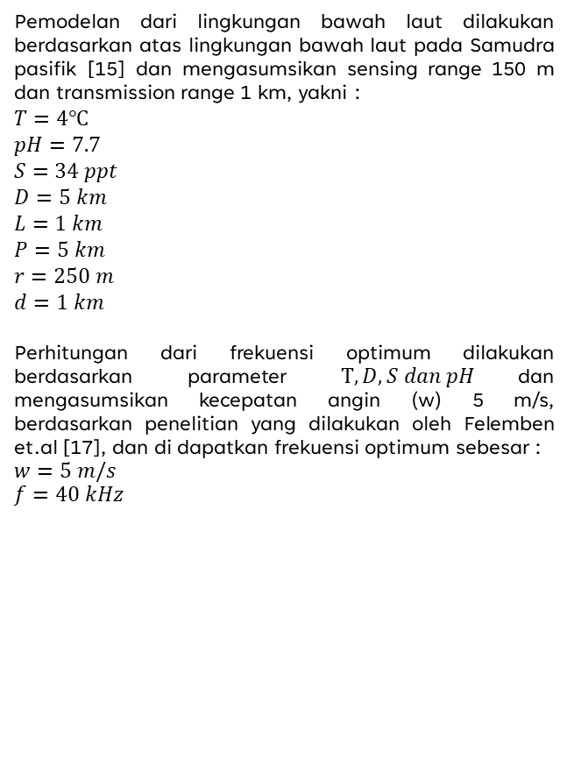




SIMULATION
$$∆z_{1}$$
$$r=150 m$$
$$D=1 km$$
Pemodelan dari lingkungan bawah laut dilakukan berdasarkan atas lingkungan bawah laut pada Samudra pasifik [15] dan mengasumsikan sensing range 150 m dan transmission range 1 km, yakni :
$$T=4℃$$
$$pH=7.7$$
$$S=34 ppt$$
$$D=5 km$$
$$L=1 km$$
$$P=5 km$$
$$r=250 m$$
$$d=1 km$$
Perhitungan dari frekuensi optimum dilakukan berdasarkan parameter $T, D, S dan pH$dan mengasumsikan kecepatan angin (w) 5 m/s, berdasarkan penelitian yang dilakukan oleh Felemben et.al [17], dan di dapatkan frekuensi optimum sebesar :
$w=5 m/s$
$$f=40 kHz$$
$$∆z_{layer}$$
$$L=1 km$$
$$P=1 km$$
$$∆z=D/r$$

Slide 9
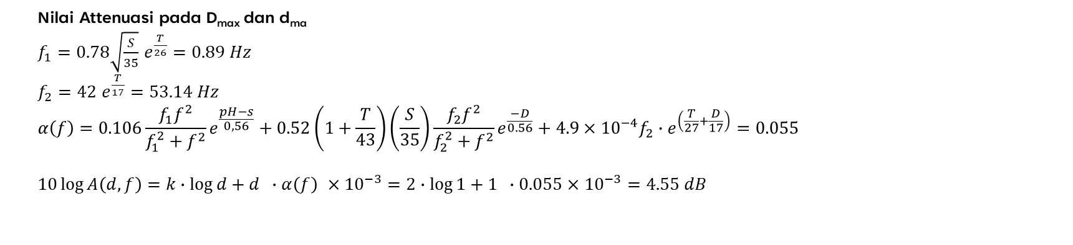
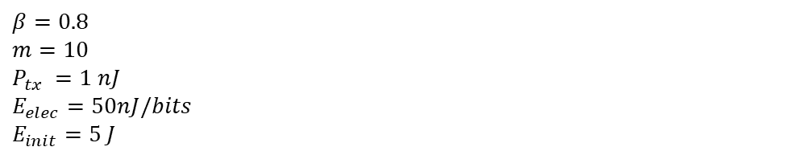
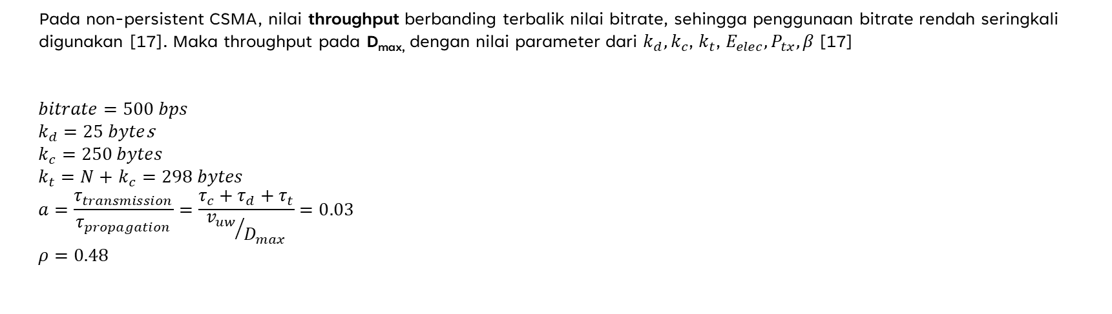
SIMULATION
Nilai Attenuasi pada D_{max} dan d_{ma}
$f_{1}=0.78\sqrt{\frac{S}{35}}$ $e^{\frac{T}{26}}=0.89 Hz$
$f_{2}=42$ $e^{\frac{T}{17}}=53.14 Hz$
$$α\left(f\right)=0.106\frac{f_{1}f^{2}}{f_{1}^{2}+f^{2}}e^{\frac{pH−s}{0,56}}+0.52\left(1+\frac{T}{43}\right)\left(\frac{S}{35}\right)\frac{f_{2}f^{2}}{f_{2}^{2}+f^{2}}e^{\frac{−D}{0.56}}+4.9×{10}^{−4}f_{2}∙e^{\left(\frac{T}{27}+\frac{D}{17}\right)}=0.055$$
$$10\log{A\left(d,f\right)}=k∙\log{d+d} ∙α\left(f\right) ×{10}^{−3}=2∙\log{1+1} ∙0.055×{10}^{−3}=4.55 dB$$
Nilai kecepatan propagasi underwater pada D_{max}
$$v_{uw}=1633.57 m/s$$
Pada non-persistent CSMA, nilai throughput berbanding terbalik nilai bitrate, sehingga penggunaan bitrate rendah seringkali digunakan [17]. Maka throughput pada D_{max,} dengan nilai parameter dari $k_{d},k_{c}$, $k_{t}$, $E_{elec},P_{tx},β$[17]
$$bitrate=500 bps$$
$k_{d}=25 byte$s
$$k_{c}=250 bytes$$
$k_{t}=N+$ $k_{c}=298 bytes$
$$a=\frac{τ_{transmission}}{τ_{propagation}}=\frac{τ_{c}+τ_{d}+τ_{t}}{{v_{uw}}/{D_{max}}}=0.03$$
$$ρ=0.48$$
$$β=0.8$$
$$m=10$$
$$P_{tx} =1 nJ$$
$$E_{elec}=50nJ/bits$$
$$E_{init}=5 J$$

Slide 10
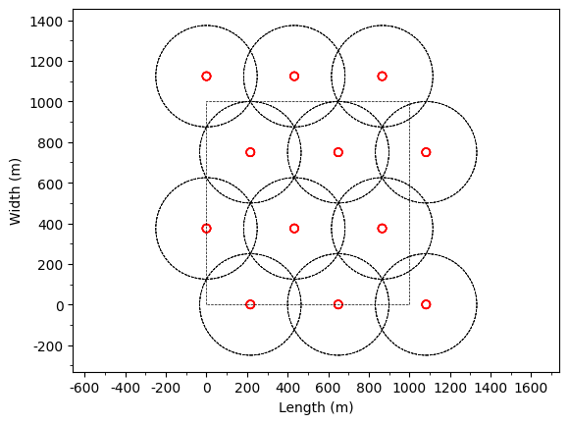
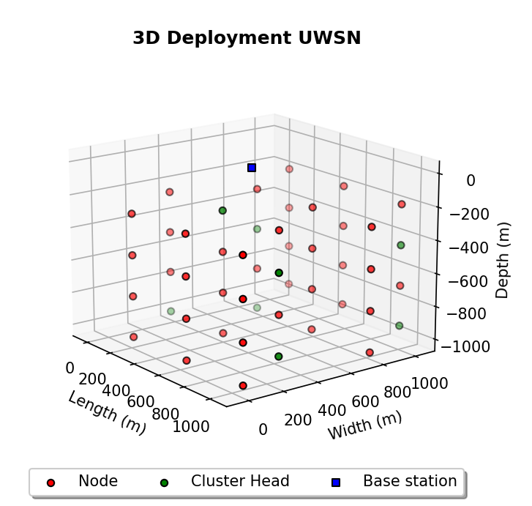
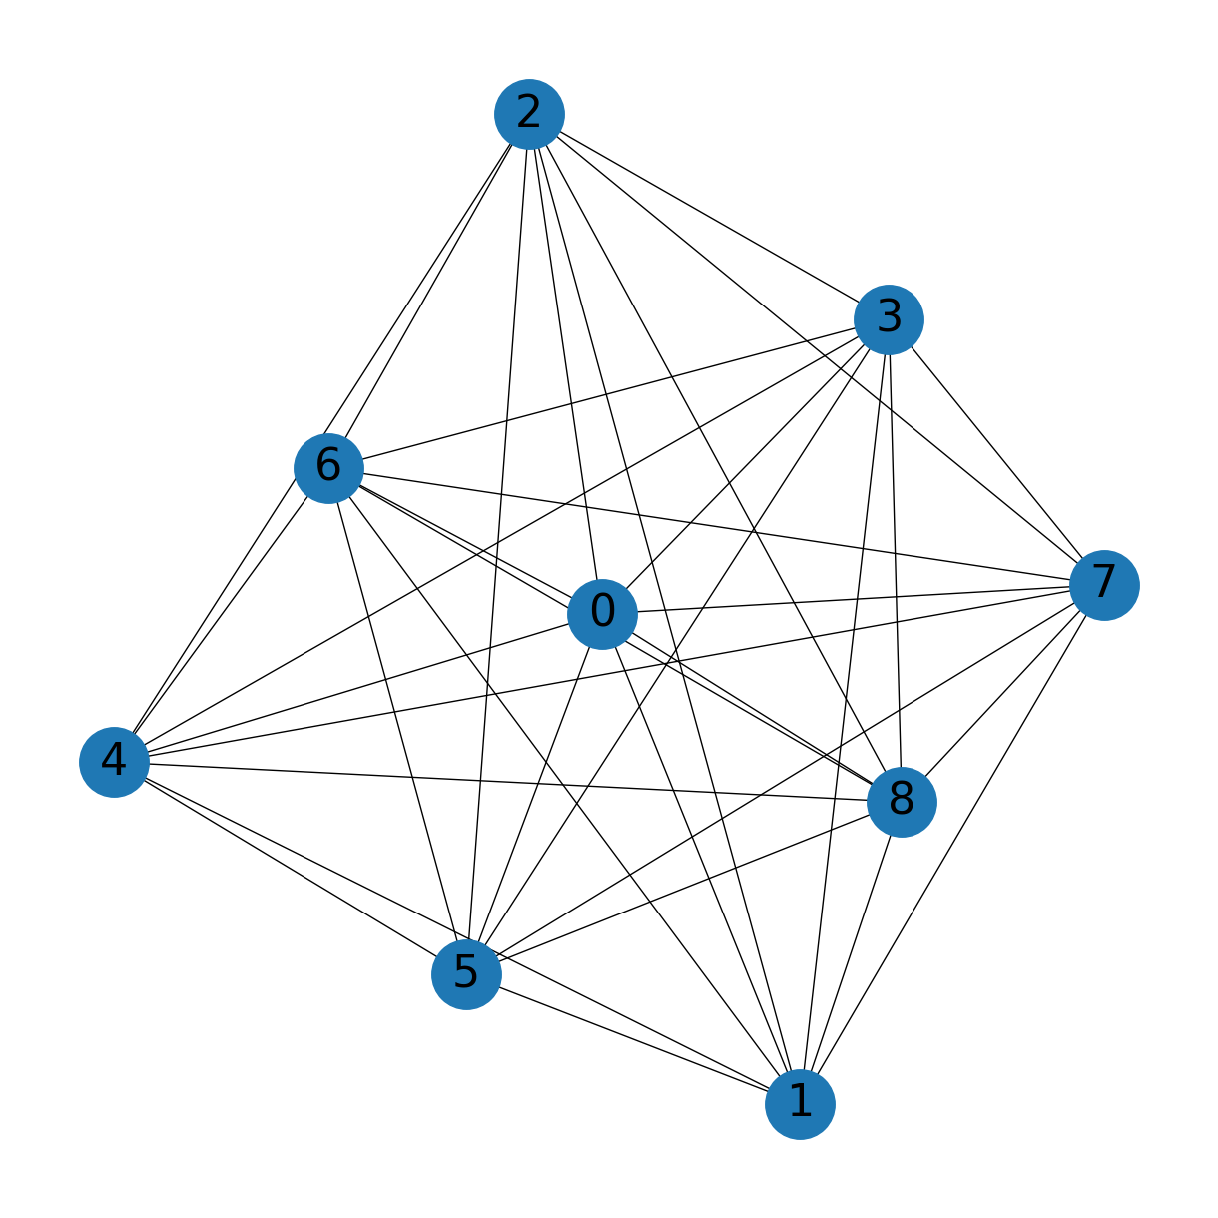
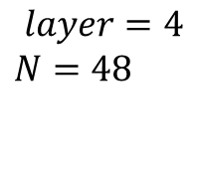

SIMULATION
$$layer=4$$
$$N=48$$
$$K=8$$

Slide 11
REFERENCES
[1] K. Wang, H. Gao, X. Xu, J. Jiang, and D. Yue, “An Energy-Efficient Reliable Data Transmission Scheme for Complex Environmental Monitoring in Underwater Acoustic Sensor Networks,” IEEE Sens J, vol. 16, no. 11, pp. 4051–4062, Jun. 2016, doi: 10.1109/JSEN.2015.2428712.
[2] K. Munasinghe, M. Aseeri, S. Almorqi, M. F. Hossain, M. Binte Wali, and A. Jamalipour, “EM-Based High Speed Wireless Sensor Networks for Underwater Surveillance and Target Tracking,” J Sens, vol. 2017, 2017, doi: 10.1155/2017/6731204.
[3] A. H. Quazi and W. L. Konrad, “Underwater acoustic communications,” IEEE Communications Magazine, vol. 20, no. 2, pp. 24–30, Mar. 1982, doi: 10.1109/MCOM.1982.1090990.
[4] Rizvi, Huma Hasan, Sadiq Ali Khan, and Rabia Noor Enam. "Clustering base energy efficient mechanism for an underwater wireless sensor network." Wireless Personal Communications 124.4 (2022): 3725-3741.
[5] Omeke, Kenechi G., et al. "DEKCS: A dynamic clustering protocol to prolong underwater sensor networks." IEEE Sensors Journal 21.7 (2021): 9457-9464.
[6] Krishnaswamy, Vani, and Sunil Kumar S. Manvi. "Clustering and data aggregation scheme in underwater wireless acoustic sensor network." TELKOMNIKA (Telecommunication Computing Electronics and Control) 17.4 (2019): 1604-1614.
[7] He, Shukun, et al. "The optimization of nodes clustering and multi-hop routing protocol using hierarchical chimp optimization for sustainable energy efficient underwater wireless sensor networks." Wireless Networks (2023): 1-20
[8] Sivakumar, V., et al. "Energy-efficient markov-based lifetime enhancement approach for underwater acoustic sensor network." Journal of Sensors 2022 (2022): 1-10.
[9] Hu, Tiansi, and Yunsi Fei. "QELAR: A machine-learning-based adaptive routing protocol for energy-efficient and lifetime-extended underwater sensor networks." IEEE transactions on mobile computing 9.6 (2010): 796-809.
[10] Subramani, Neelakandan, et al. "An efficient metaheuristic-based clustering with routing protocol for underwater wireless sensor networks." Sensors 22.2 (2022): 415.

Slide 12
REFERENCES
[11] Pompili, Dario, Tommaso Melodia, and Ian F. Akyildiz. "Three-dimensional and two-dimensional deployment analysis for underwater acoustic sensor networks." Ad Hoc Networks 7.4 (2009): 778-790.
[12] Sehgal, Anuj. Analysis & Simulation of the Deep Sea Acoustic Channel for Sensor Networks. Lulu. com, 2013.
[13] Enam, R. Noor, Mumtazul Imam, and R. Inam Qureshi. "Energy consumption in random cluster head selection phase of WSN." International Proceedings of Computer Science & Information Tech 30 (2012): 38-44.
[14] Rizvi, Huma Hasan, et al. "Adaptive energy efficient circular spinning protocol for dynamic cluster based UWSNs." IEEE Access 10 (2022): 61937-61950
[15] Ainslie, Michael A., and James G. McColm. "A simplified formula for viscous and chemical absorption in sea water." The Journal of the Acoustical Society of America 103.3 (1998): 1671-1672.
[16] Felemban, Emad. "Acoustic Frequency Optimization for Underwater Wireless Sensor Network." International Journal of Advanced Computer Science and Applications 11.6 (2020).
[17] Aljanabi, Amer, et al. "Low Complexity Single Carrier Frequency Domain Detectors for Internet of Underwater Things (IoUT) s." Wireless Personal Communications 125.3 (2022): 2443-2461
[18] Liang, Wei, et al. "Experiment research on underwater acoustic sensor network." 2007 International Conference on Wireless Communications, Networking and Mobile Computing. IEEE, 2007.
.

Slide 13
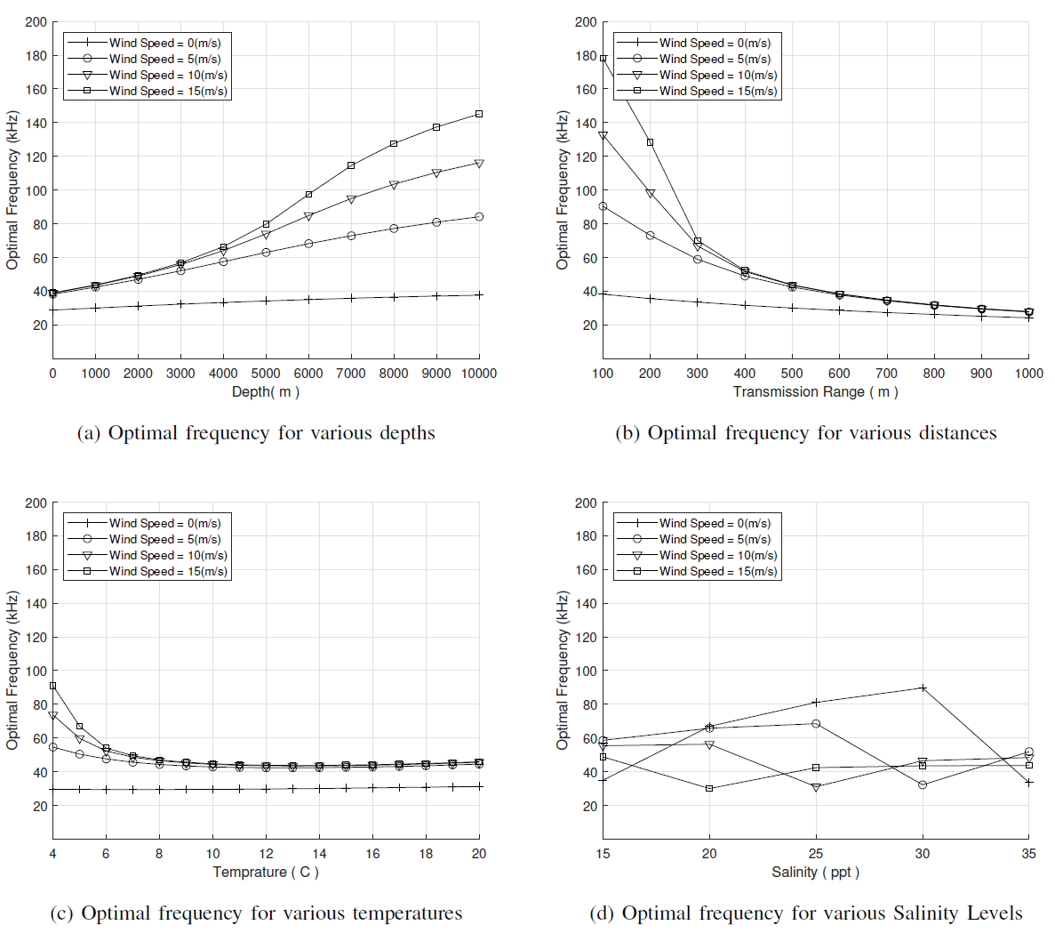
APPENDIX

Slide 14
BIMBINGAN KE-3
14/12/2023

Slide 15
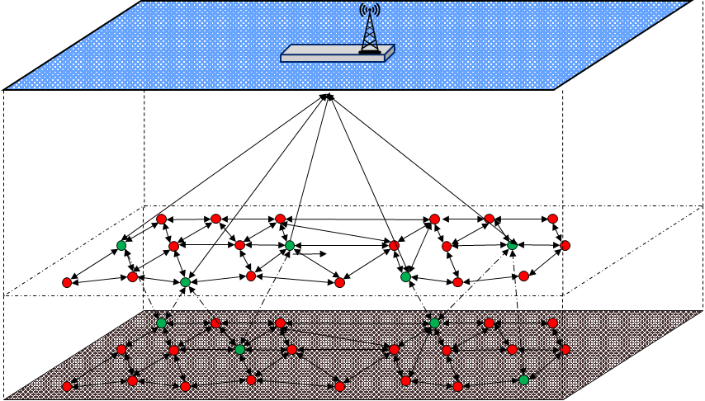
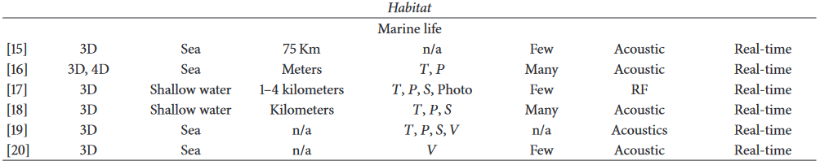
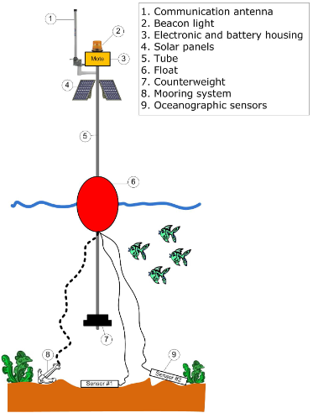
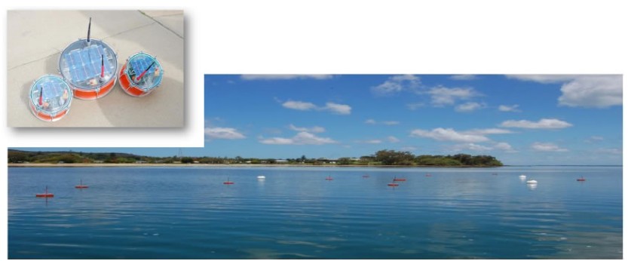
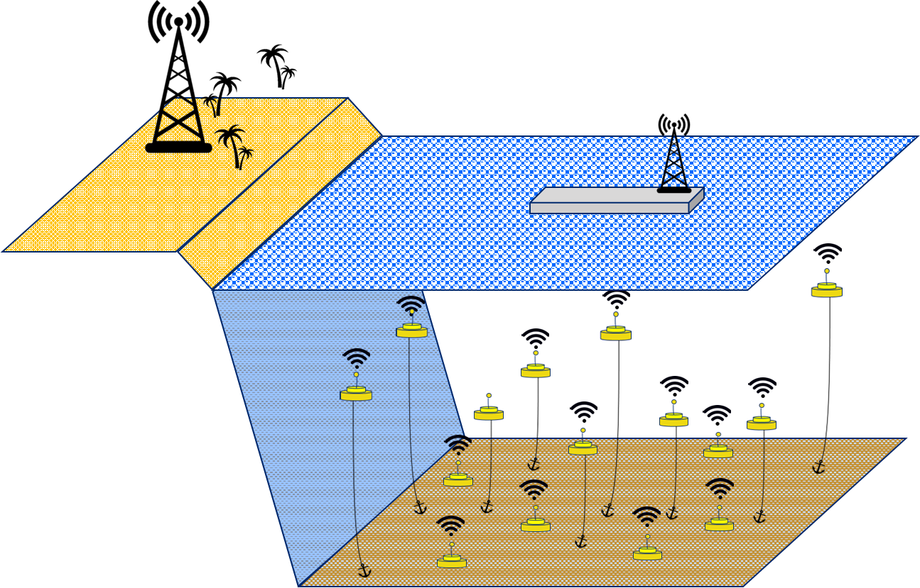
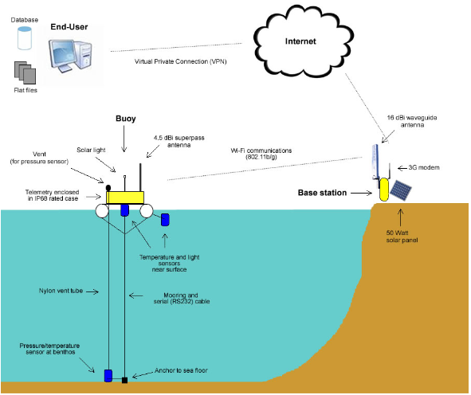
APLICATION OF UWSN
[3]
[2]
[1]

Slide 16
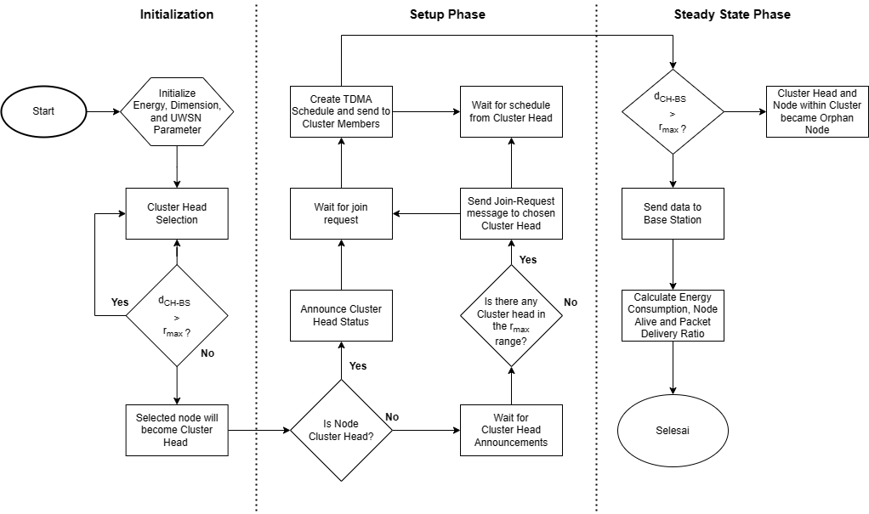
LEACH FLOWCHART
pH | : | 7,7
T | : | 4
S | : | 34
K_{c} | : | 25
K_{d} | : | 250
N | : | 48
E_{elec} | : | 50 nJ
P_{tx} | : | 1 mW
Data rate | : | 500 bps
k | : | 3
Panjang | : | 1000 m
Lebar | : | 1000 m
Tinggi | : | 1000 m

Slide 17
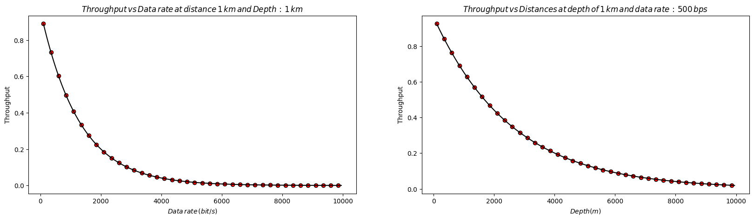
CSMA ANALYSIS
Zhao, Qichao, Andrew J. Lambert, and Craig R. Benson. "A note on CSMA performance in underwater acoustic networks." Computer Communications 55 (2015): 62-68.

Slide 18
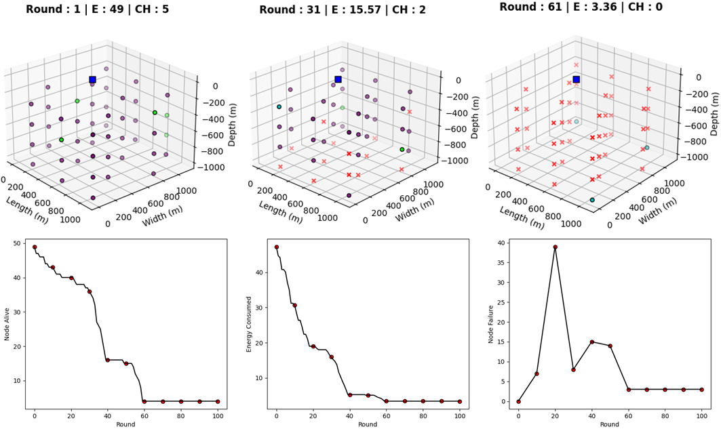
LEACH PERFORMANCE

Slide 19
KOMPARASI
AUTHORS | TECHNIQUE | DEPLOYMENT | SCALABILITY | ENERGY EFFICIENCY | LOAD DISTRIBUTION | COMPLEXITY | LIMITATION
ULEACH | Random based cluster head saelection | Random 3D | Low | Low | Low | Low | CH selection is based on random probability Node failure easily occurs during single hop transmission
DEKCS | Energy based K-Means clustering | Random 2D | Low | Moderate | Moderate | Moderate | CH selection is based on constant energy threshold Node failure easily occurs during single hop transmission
QELAR | Q-Learning Multi-Hop | Random 3D waypoint | High | Moderate | High | High | High energy overhead due to flat-based protocol
Proposed Method | K-Means Clustering and Q-Learning Multi Hop | Multi Layer Trilateration | High | High | High | High

Slide 20
REFERENCES
[1] J. Trevathan et al., “SEMAT — The Next Generation of Inexpensive Marine Environmental Monitoring and Measurement Systems,” Sensors 2012, Vol. 12, Pages 9711-9748, vol. 12, no. 7, pp. 9711–9748, Jul. 2012, doi: 10.3390/S120709711.
[2] C. A. Pérez, M. Jimenéz, F. Soto, R. Torres, J. A. López, and A. Iborra, “A system for monitoring marine environments based on wireless sensor networks,” OCEANS 2011 IEEE - Spain, 2011, doi: 10.1109/OCEANS-SPAIN.2011.6003584.
[3] Felemban, Emad, et al. "Underwater sensor network applications: A comprehensive survey." International Journal of Distributed Sensor Networks 11.11 (2015): 896832.

Slide 21
Thank you
Mirjam Nilsson​
mirjam@contoso.com
www.contoso.com

Slide 22







